Slide 1
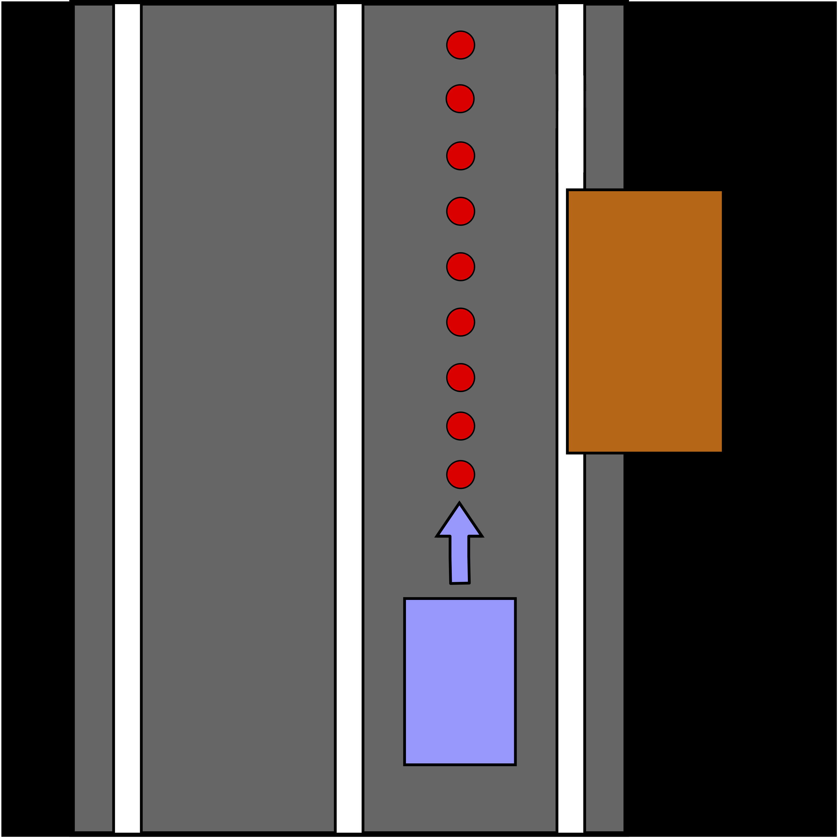
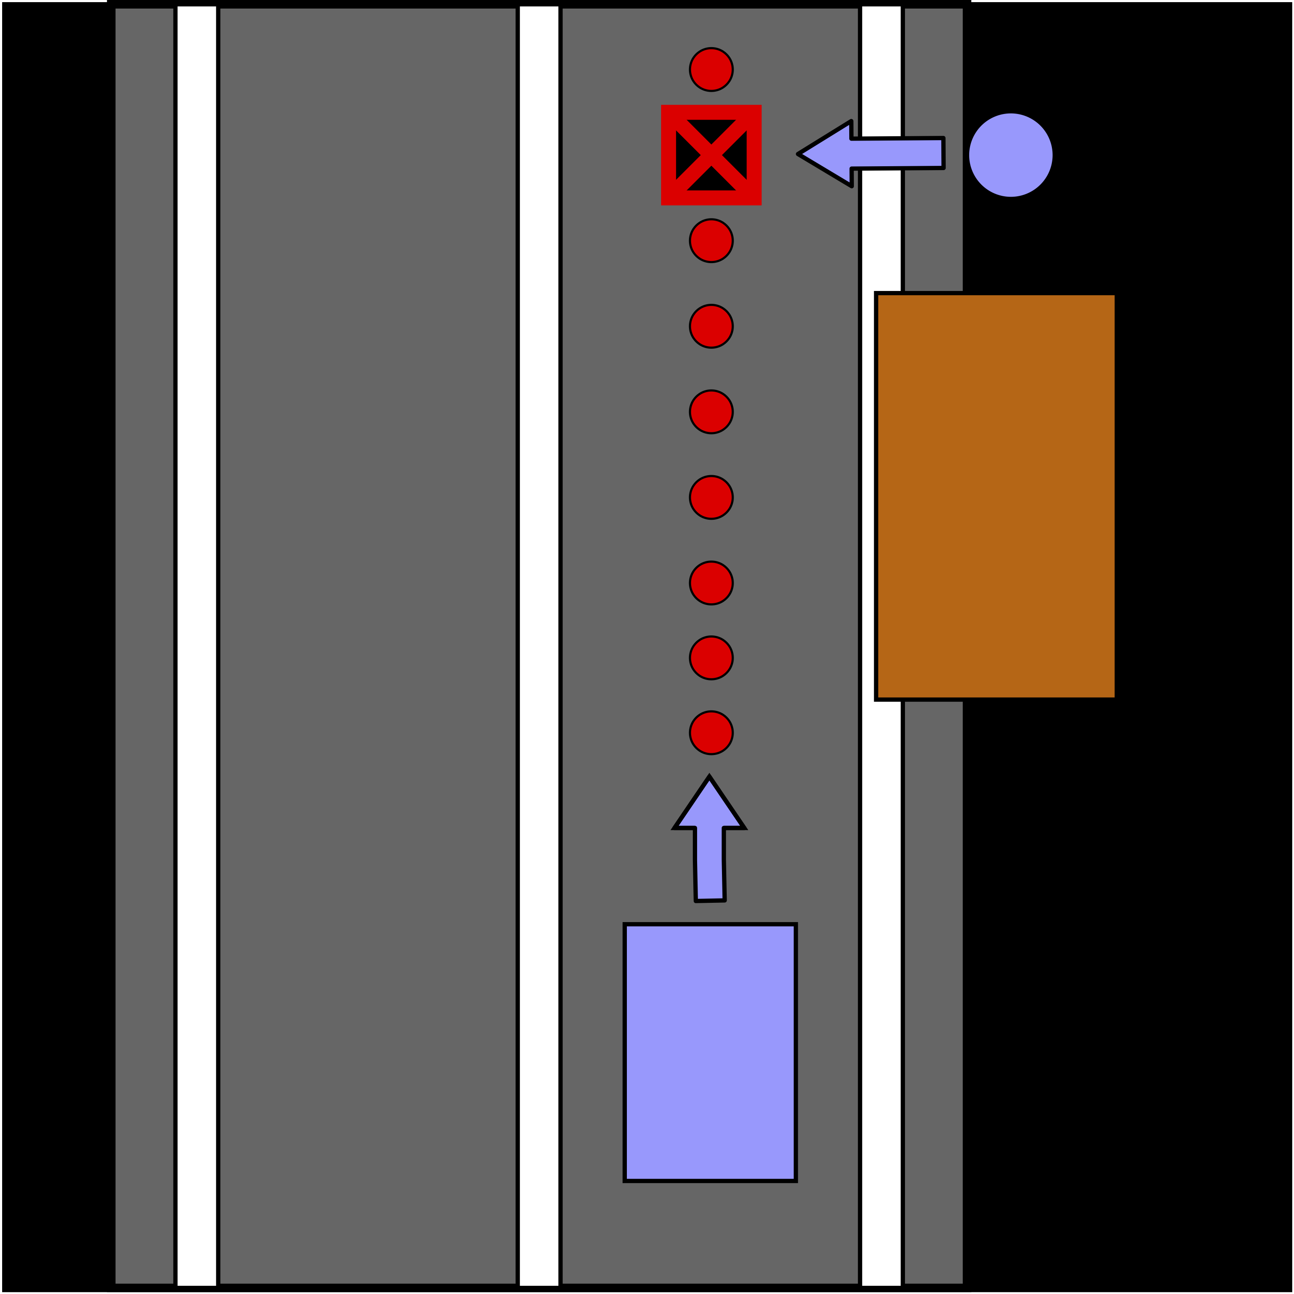
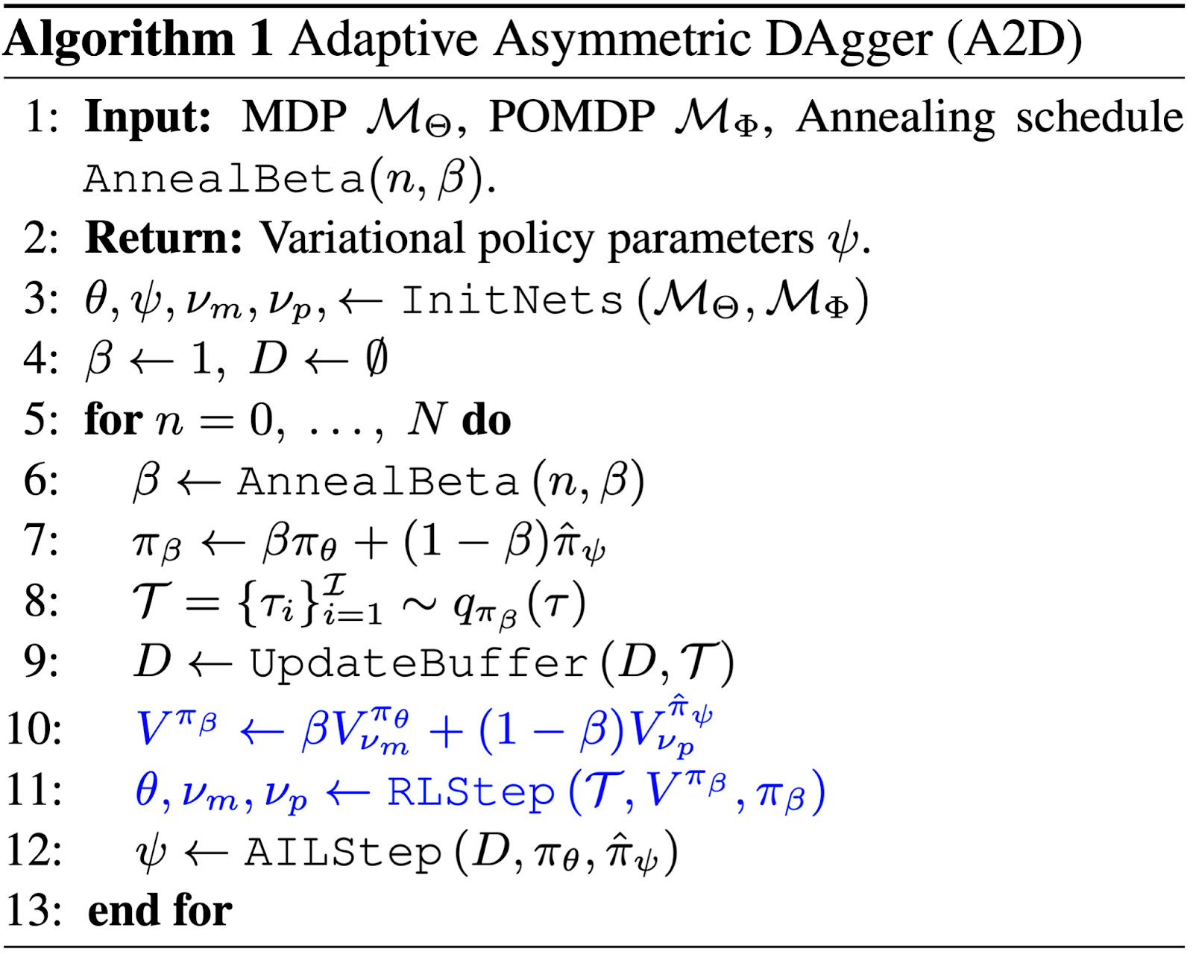
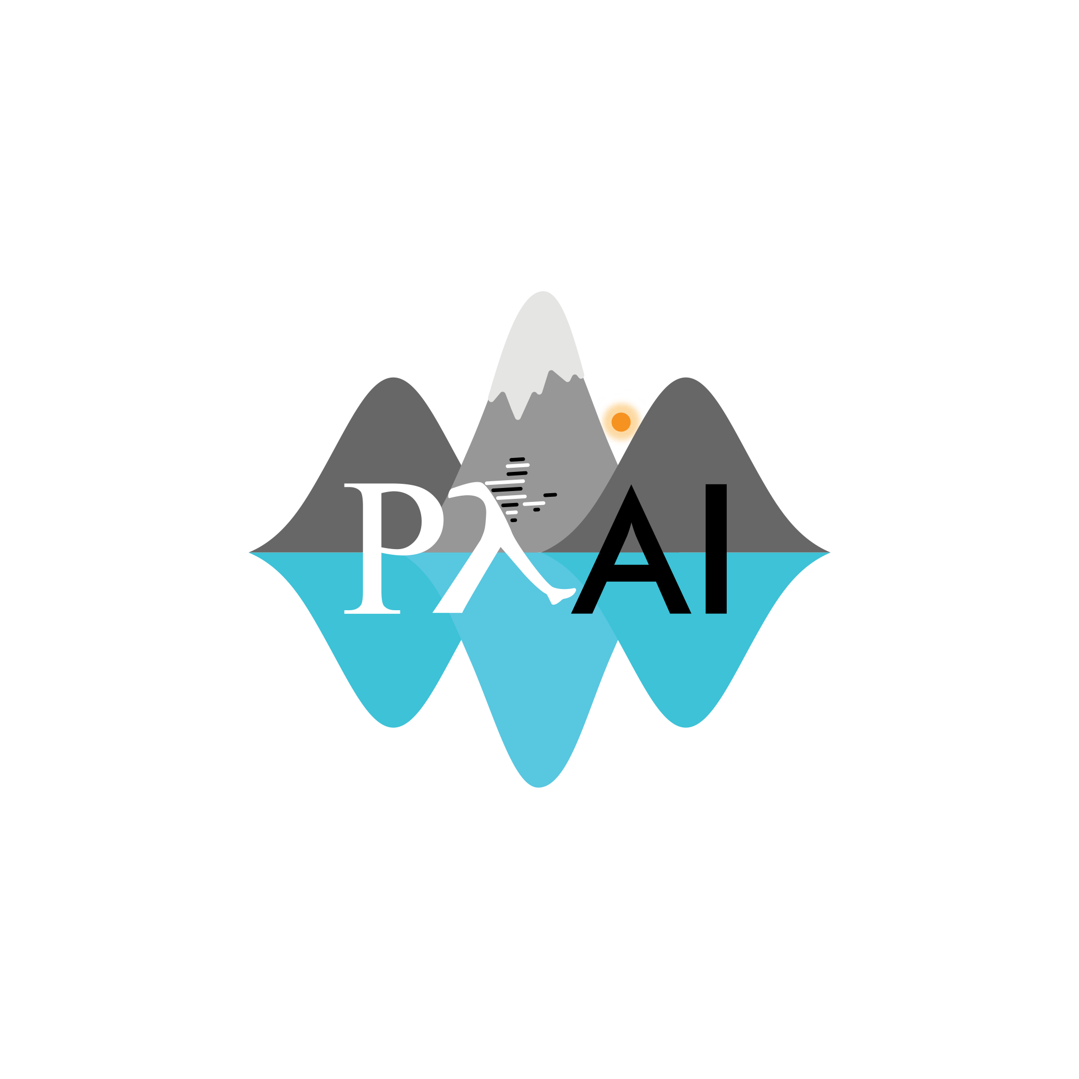
Robust Asymmetric Learning in POMDPs
Andrew Warrington*, J. Wilder Lavington*, Adam Ścibior, Mark Schmidt & Frank Wood
*Denotes Equal Contribution, Paper ID XXX, Poster Number XXX, XXX@XXX
TL;DR
Help
A2D Update
Help
Gridworld
Help
Asymmetric Environments
Help
Autonomous Vehicles
Help
Asymmetric Imitation Learning
Help
Figure X.a: A2D converges to a policy with a higher reward more quickly and reliably than direct RL. AIL converges to a bad policy.
Figure X.b: A2D converges to a policy that hits more waypoints, suggesting that the MDP representation allows for more efficient supervision.
Figure X.c: A2D learns a policy that avoids the child in a high
A2D Algorithm
Help
Source Code & Additional Materials
Source code: www.github.com/plai-group/a2d
Also includes links and materials for talk, poster & paper.
Informal blog post available at XXX.com
Key References
Help

